Slide 1

Example:
Magnetic field of a Helmholtz coil

Slide 2
Introduction
Helmholtz Coil
A Helmholtz coil is a parallel pair of identical circular coils spaced one radius apart and wound so that the current flows through both coils in the same direction.
This winding results in a very uniform magnetic field between the coils.
The purpose is to allow scientists and engineers to perform experiments and tests that require a known ambient magnetic field.
Helmholtz field generation can be static, time-varying DC or AC, depending on applications.

Slide 3
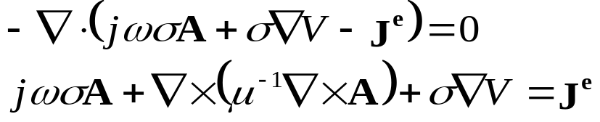
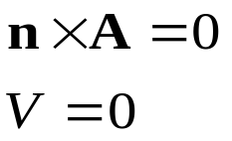
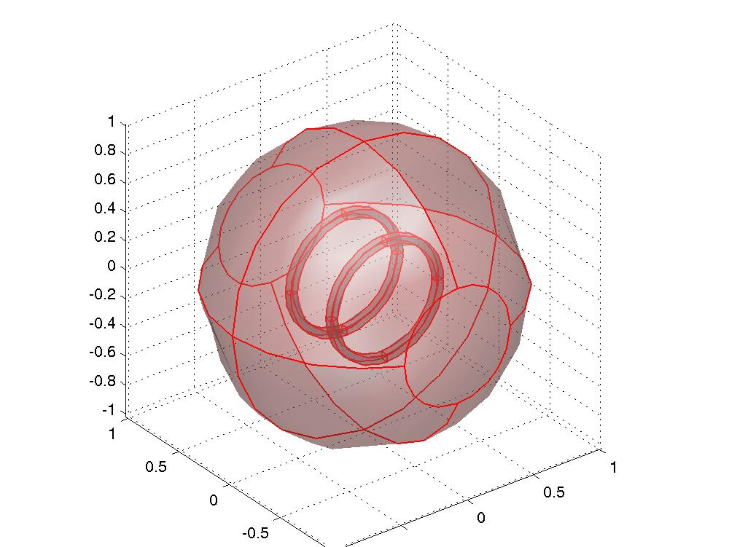
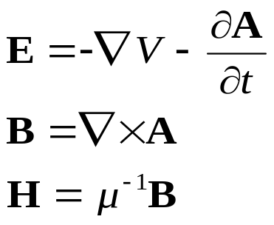
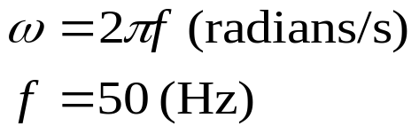
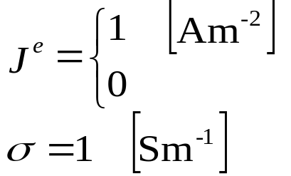
Domain equations and boundary conditions
Helmholtz Coil – Problem Definition
(in coil)

Slide 4
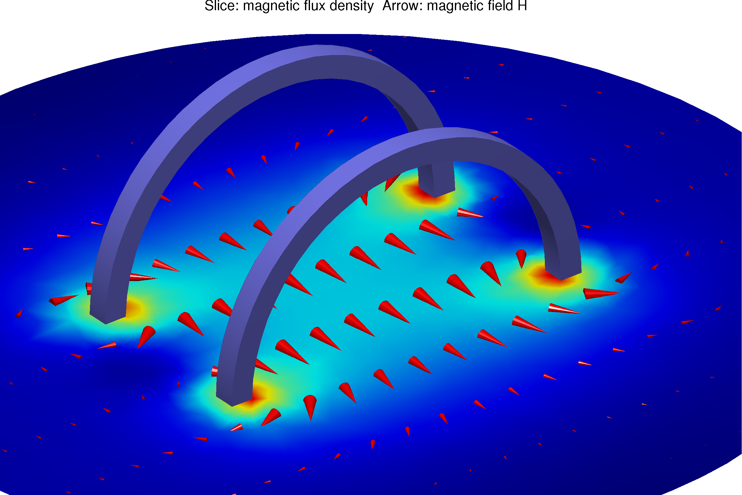
Magnetic flux density and H-field vectors
Helmholtz Coil – Results

Slide 5
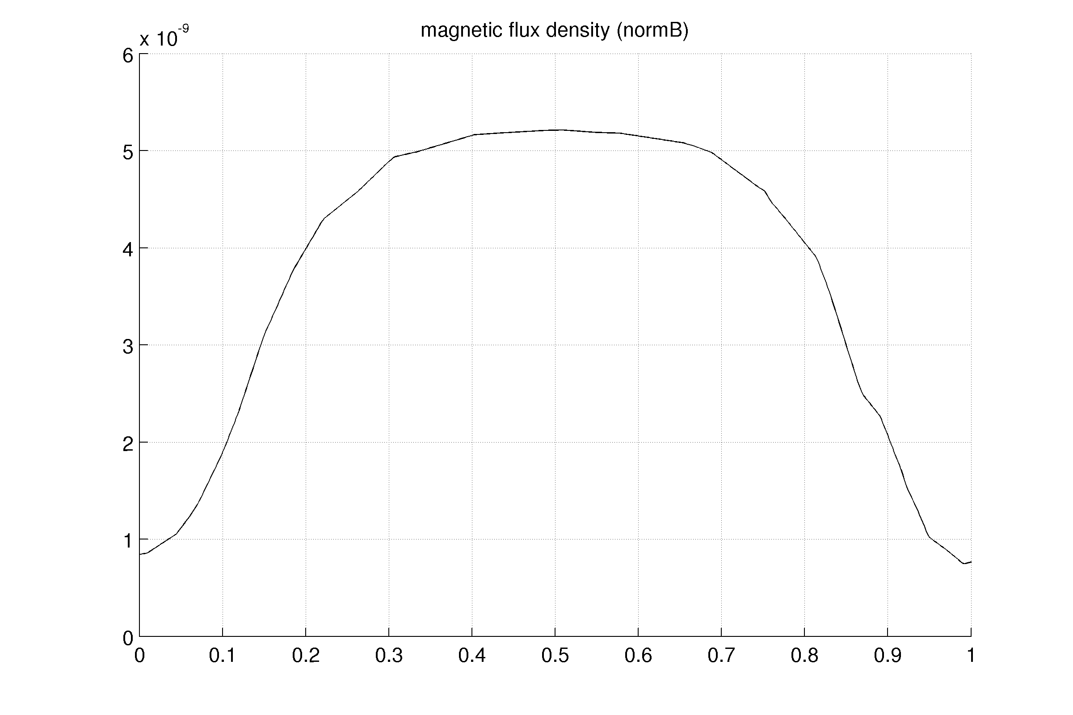
Radial profile
Helmholtz Coil – Results
coil position

Slide 6
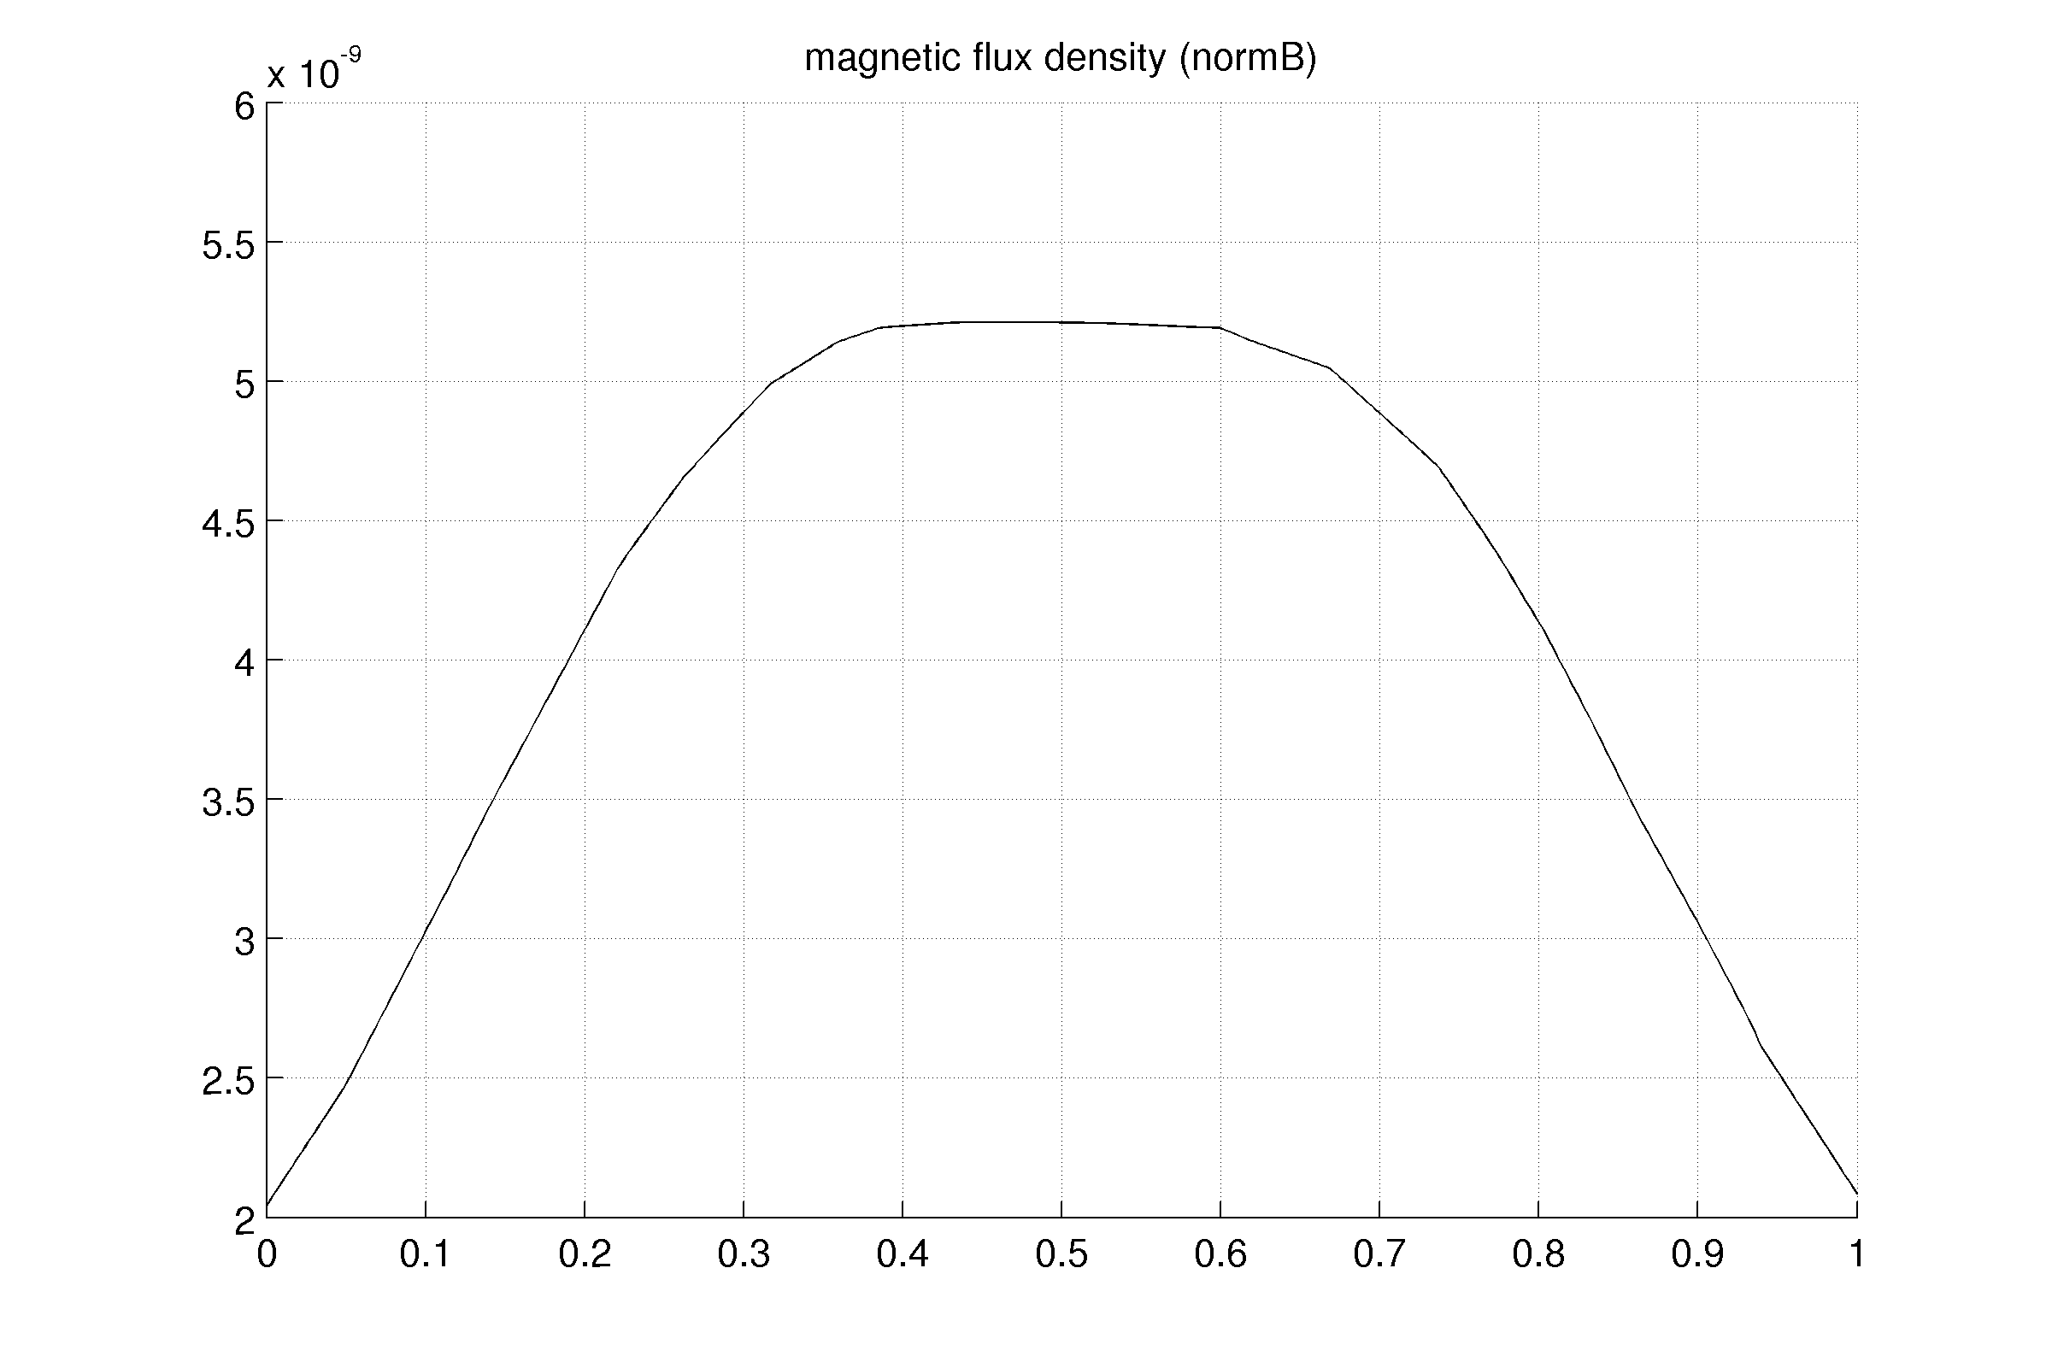
Axial profile
Helmholtz Coil – Results
coil position

Slide 7
Conclusions
Helmholtz Coil – Conclusions
B is uniform in a large region.
The problem is axisymmetric.
3D model allows for the introduction of non axisymmetric test objects

